Slide 1
TITLE: ANALYZING THE TUBERCULOSIS TRENDS AND DEMOGRAPHICS IN CALIFORNIA
Revathi Surisetty

Slide 2
Table of contents:
Introduction
Background
Data Description
Data Attributes
Visualizations of Data
Confusion matrix of Data
Linear Regression of Data
KNN Model
Kernal's Model
Random Forest Model

Slide 3
INTRODUCTION:
Tuberculosis:
A potentially serious infectious bacterial disease that mainly affects the lungs.
Now-a-days this tuberculosis is gradually increasing, and it is becoming a major public concern throughout the world.
In California, one of the most populated and diverse states in the US, tuberculosis (TB) still affects communities despite advances in treatment and prevention.
Effective planning and action in public health requires an understanding of the distribution and trends of tuberculosis cases across different demographic groups and geographic areas
Data Collection
We have gathered the data from the data.gov
Tuberculosis Case Numbers and Rates, California and Local Health Jurisdictions - TB by place of birth, age, sex and race/ethnicity - Catalog
Tuberculosis Case Numbers and Rates, California and Local Health Jurisdictions - TB in local health jurisdiction - Catalog

Slide 4
DATA DESCRIPTION:
These two datasets describes Tuberculosis ( TB) data in California reported to California Department of Public Health ( CDPH)One dataset explains about the number of active TB cases and rates by key demographic factors such as Age, Sex, Race/Ethinicity and Origin ( place of birth)
The other dataset explains about number of active TB cases and rates by local health jurisdiction i.e., around 61 local health jurisdictions ( 58 counties and cities of Berkeley, Long Beach and Pasadena)
Collectively these two datasets provides a detailed analysis of TB cases in California, enabling the distribution of resources and focused public health initiatives for efficient tuberculosis control and prevention.

Slide 5
DATA ATTRIBUTES:
Data Attributes :The unique columns in a dataset that represent different facets of the data are known as data attributes.
Citation:
https://catalog.data.gov/dataset/tuberculosis-case-numbers-and-rates-california-and-local-health-jurisdictions-3497b/resource/b321c628-3952-41a8-a4b5-3404d9759343

Slide 6

Attributes of Dataset 1 :
Year
Category (Age group Race/ethnicity, Origin, Sex)
Cases
Strata

Slide 7
Attributes of Dataset 2 :
Year
Jurisdiction
Cases
Population Rate per 100,000 Population

Slide 8

Here we are taking cases and populations features in dataset to visualize the main reason is When analyzing tuberculosis (TB) trends in California, visualizing the relationship between TB cases and population is essential for understanding the disease's distribution and impact. It allows us to assess per capita TB rates, identifying regions with disproportionately high or low TB incidence relative to their population size. This information is critical for pinpointing high-risk areas and allocating public health resources effectively. Additionally, tracking TB cases over time against population growth helps evaluate the success of public health interventions. Overall, this approach provides valuable insights for controlling and preventing TB in California.

Slide 9
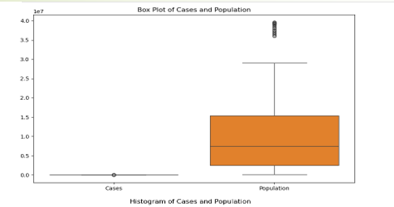
BOX PLOT:
The distribution of case counts, and population sizes is displayed in this graphic.
It is to be expected that the population box is far larger and taller than the cases box, as population numbers are often substantially greater than case numbers.
A few outliers are visible in both boxes, especially at the top, which suggests that certain jurisdictions have a disproportionately large population or number of cases.

Slide 10
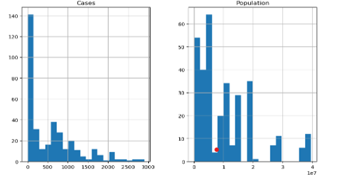
HISTOGRAM:
The frequency distribution of case counts, and population sizes is displayed in these histograms.
Given that both histograms seem to be right-skewed, many jurisdictions have lower populations and case counts, whereas fewer have extremely high numbers. -
In comparison to case numbers, the population histogram seems to have a larger range and more bars, suggesting greater fluctuation in population sizes.

Slide 11
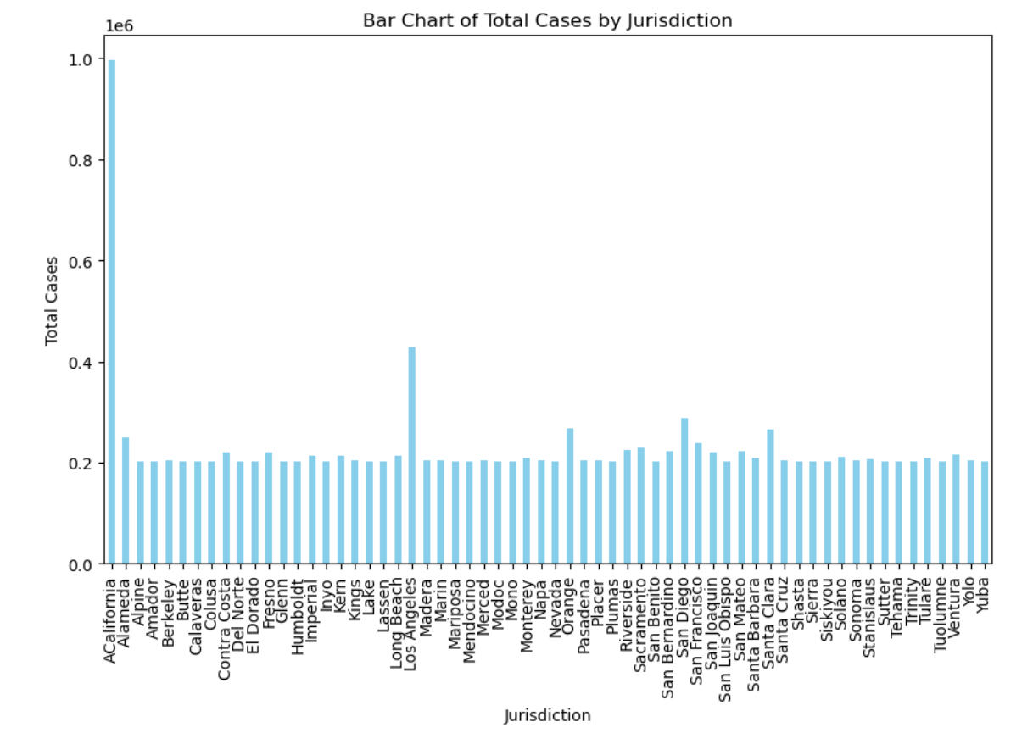
BAR CHART:
This chart displays the distribution of tuberculosis cases among various legal jurisdictions.
TB cases are distributed across various jurisdictions
It seems that certain jurisdictions have a notably greater number of cases than others.
.

Slide 12
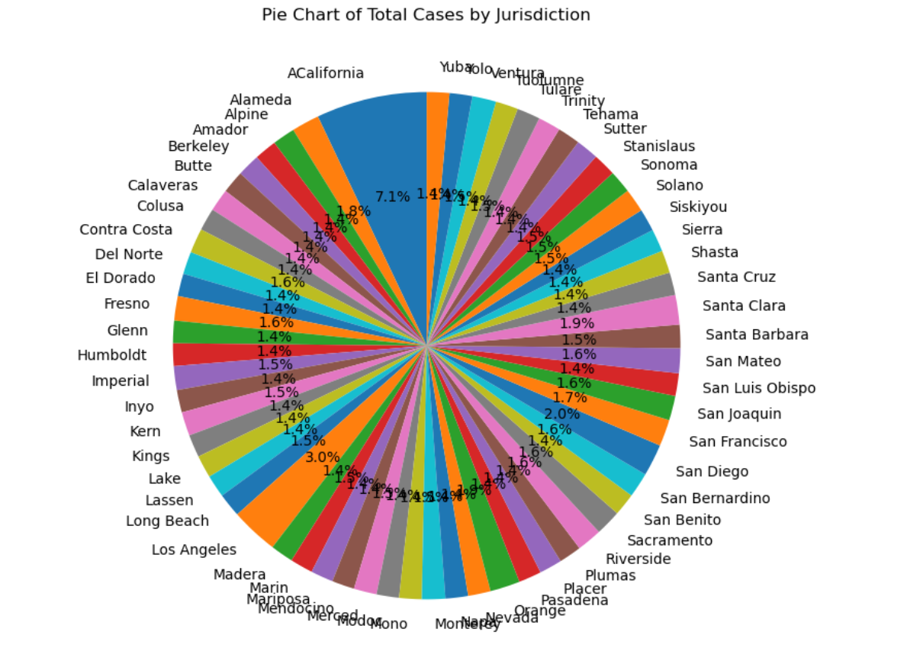
PIE CHART :
This chart shows the proportion of tuberculosis cases in each jurisdiction.
A very small proportion of instances are attributable to a limited number of jurisdictions.

Slide 13
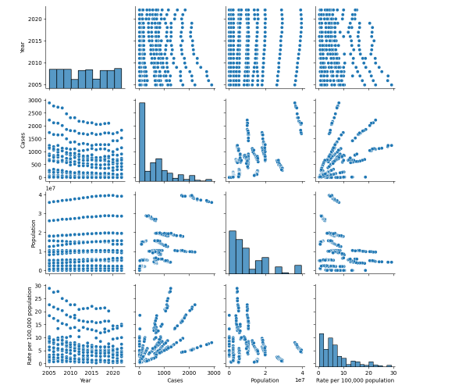
PAIR PLOT:
The scatter plot grid displays the correlations among all the numerical variables in the dataset.
The distribution of each variable is displayed separately on the diagonal.
The correlation between "Cases" and "Population," which seems to indicate a positive correlation—that is, as the population grows, so does the number of cases—may be of special interest.

Slide 14
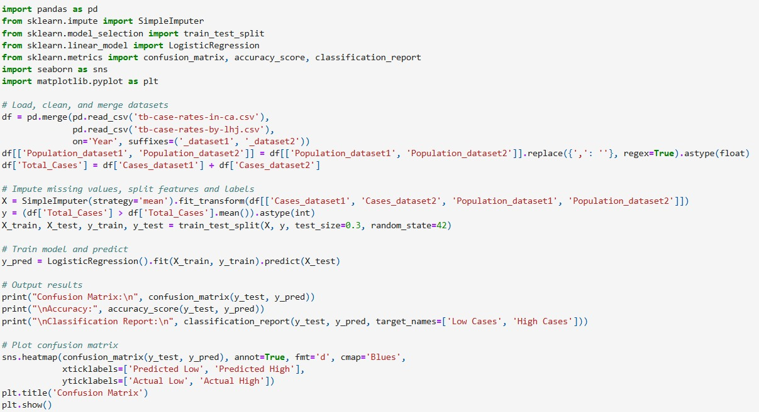
CONFUSION MATRIX :

Slide 15
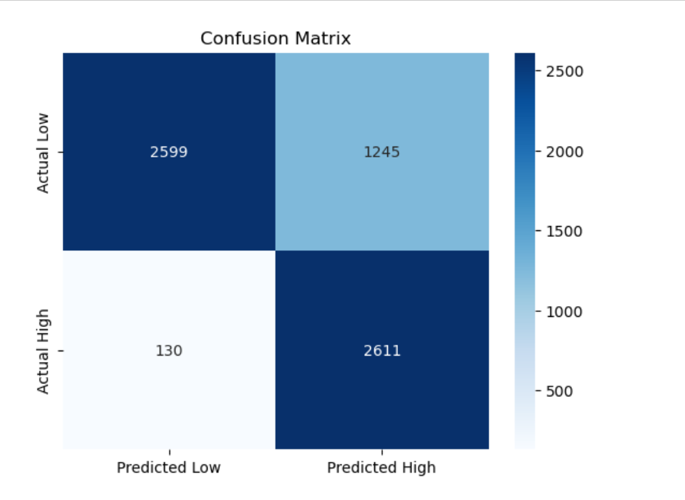
INTERPRETATION OF CONFUSION MATRIX :
The model is satisfactory with the global accuracy of the model at 79.1%.Precision is also high for Low Cases at 95%, this means that Precision for Low Cases is very good in its true positives and in correctly labeling Low Cases. However, its recall (68%) is lower than that of High Cases, implying that during each review cycle it misses approximately 32% of the actual Low Cases .Recall for High Cases indicates that is it 95% accurate in that it normally includes nearly all actual High Cases, however its precision of 68% is lower, which simply means that if it tags something as High Cases, it may well be off the mark. The F1-score of each class is 0.798 and it is something between precision and recall.

Slide 16
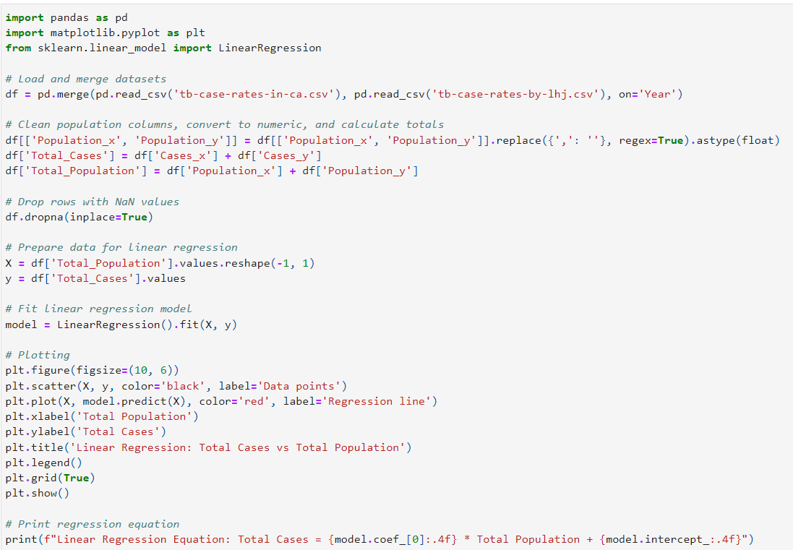
LINEAR REGRESSION:

Slide 17
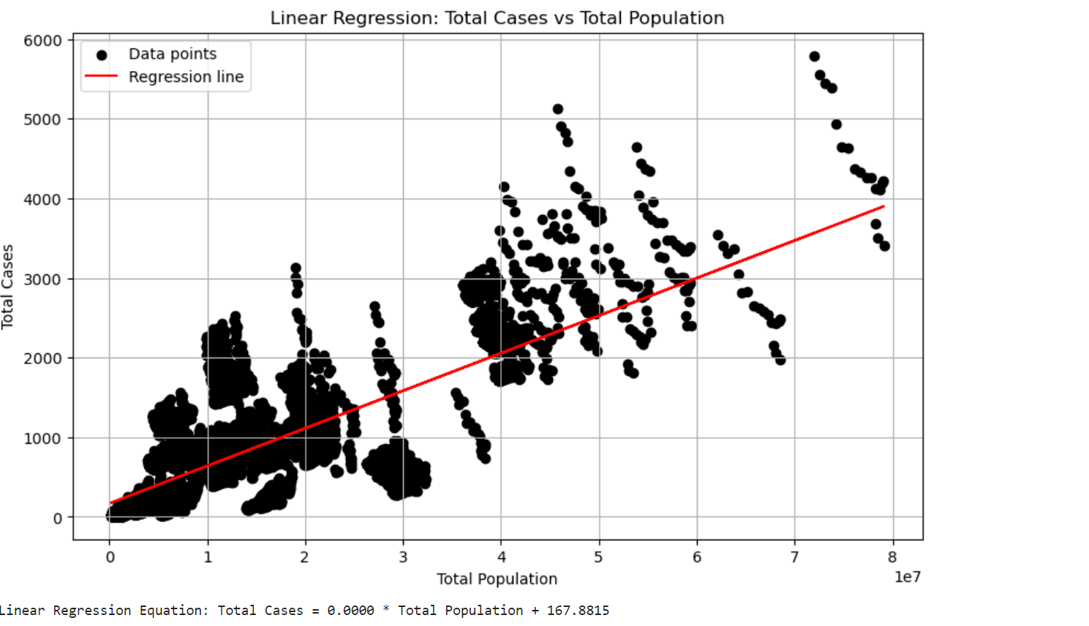
INTERPRETATION OF LINEAR REGRESSION :
The regression analysis equation-derived line y = 0.0000x + 167.8815 also supports the idea suggesting that there is no strong correlation between the overall population and the total number of cases in the sample set. This slope = 0.0000 this means that regardless of any changes in the size of population, does affect the number of cases; they remain constant. The intercept, obtained as 167.8815 is the number of cases at the time that population is equal to zero, which is actually unrealistic. In totality, from this model, we deduce that the whole population does not effectively explain the total number of cases in this data.

Slide 18
KNN & NAÏVE BAYES:
The KNN model achieved an accuracy of 0.36, whereas the Naïve Bayes model got an accuracy of 0.33.This shows that KNN outperformed the naive Bayes model on this dataset. The accuracy scores indicate that KNN was more effective at classifying the data, most likely because of its capacity to capture local patterns in the space of features.

Slide 19
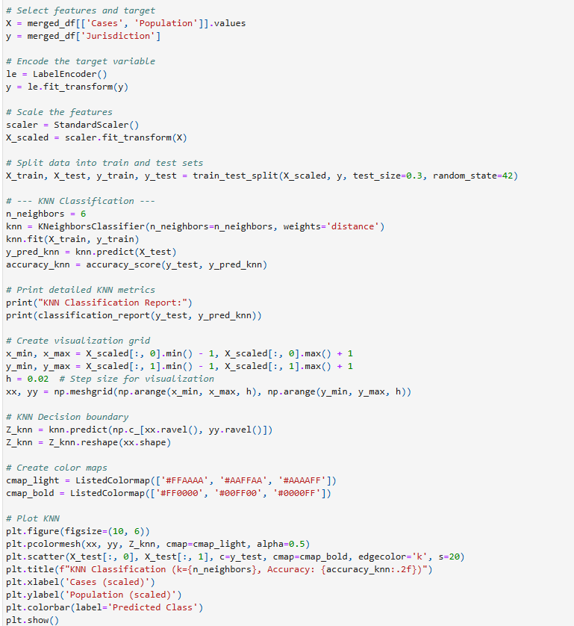
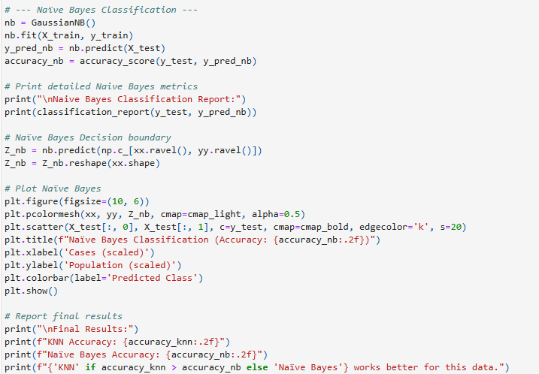
CODE
KNN
NAÏVE BAYES

Slide 20
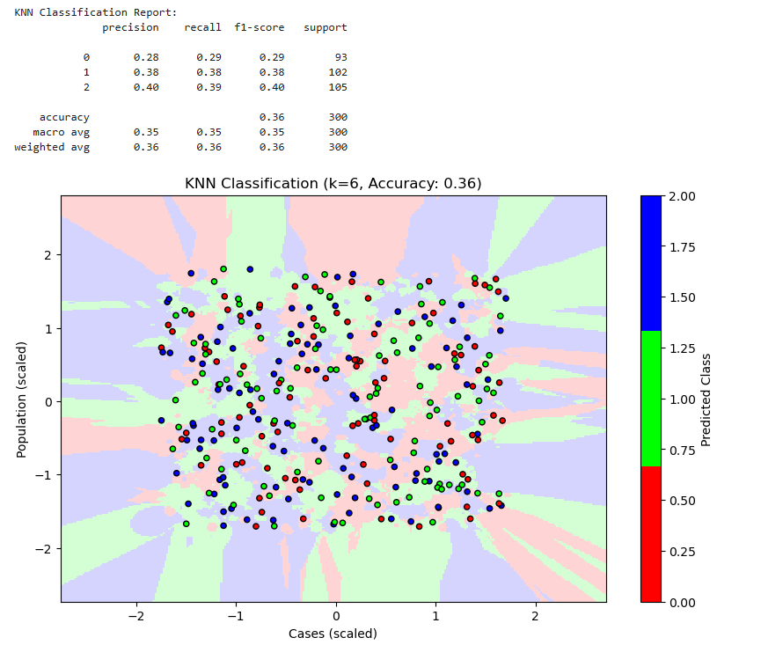
KNN ACCURACY (0.36):
KNN Accuracy (0.36):KNN's performance might be due to its non-parametric character, which enables it to adapt to the underlying data distribution without making significant assumptions. It works well when the decision boundary is irregular and can efficiently take advantage of the data's local structure. The imputation of missing values may also improve the model's performance, ensuring that the feature matrix is complete and can be used effectively for training.

Slide 21
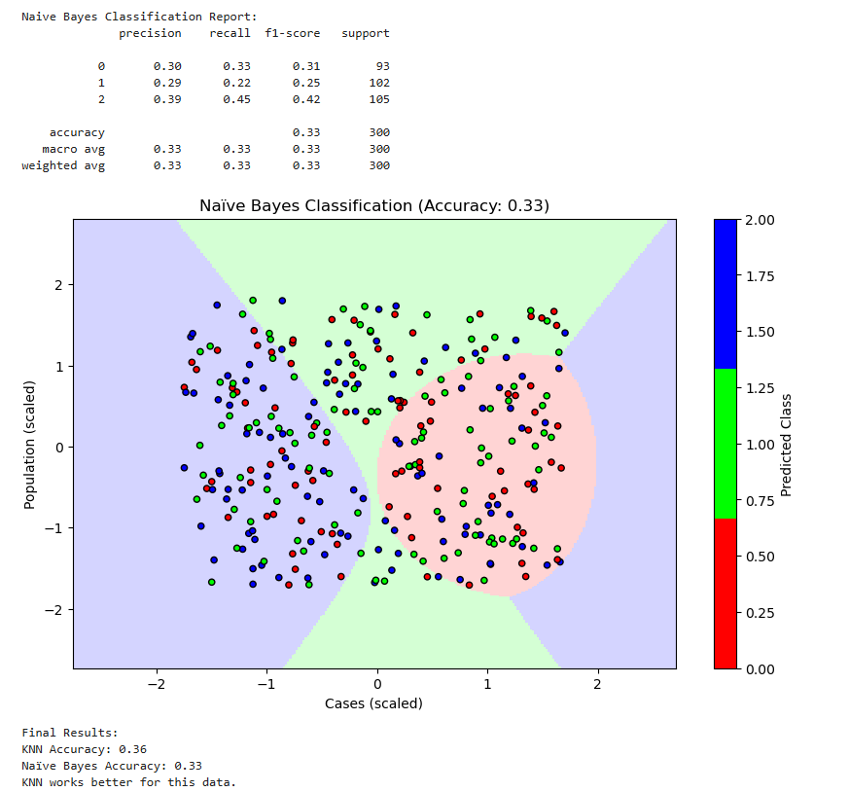
NAÏVE BAYES ACCUARCY(0.33):
Naïve Bayes Accuracy (0.33):The Naïve Bayes algorithm presupposes feature independence, which may not be true for this dataset. If the features are correlated, this assumption may result in inferior performance since it fails to capture their interactions. The decreased accuracy suggests that while Naïve Bayes is a fast and efficient model, it may not be the ideal solution for this dataset with large feature dependencies.

Slide 22
WHAT MODEL WORKS BETTER?
KNN performs better on this data because of its capacity to consider the data points' local structure. It makes no assumptions about data distribution and is adaptable to the dataset's intricacies. Naïve Bayes' independence assumption may hinder its efficiency when characteristics are linked, or data distribution is not uniform. In conclusion, the nature of the data and the relationships between features should inform the model selection. KNN outperforms Naïve Bayes in this dataset due to its flexibility and responsiveness to local patterns, resulting in improved accuracy.

Slide 23
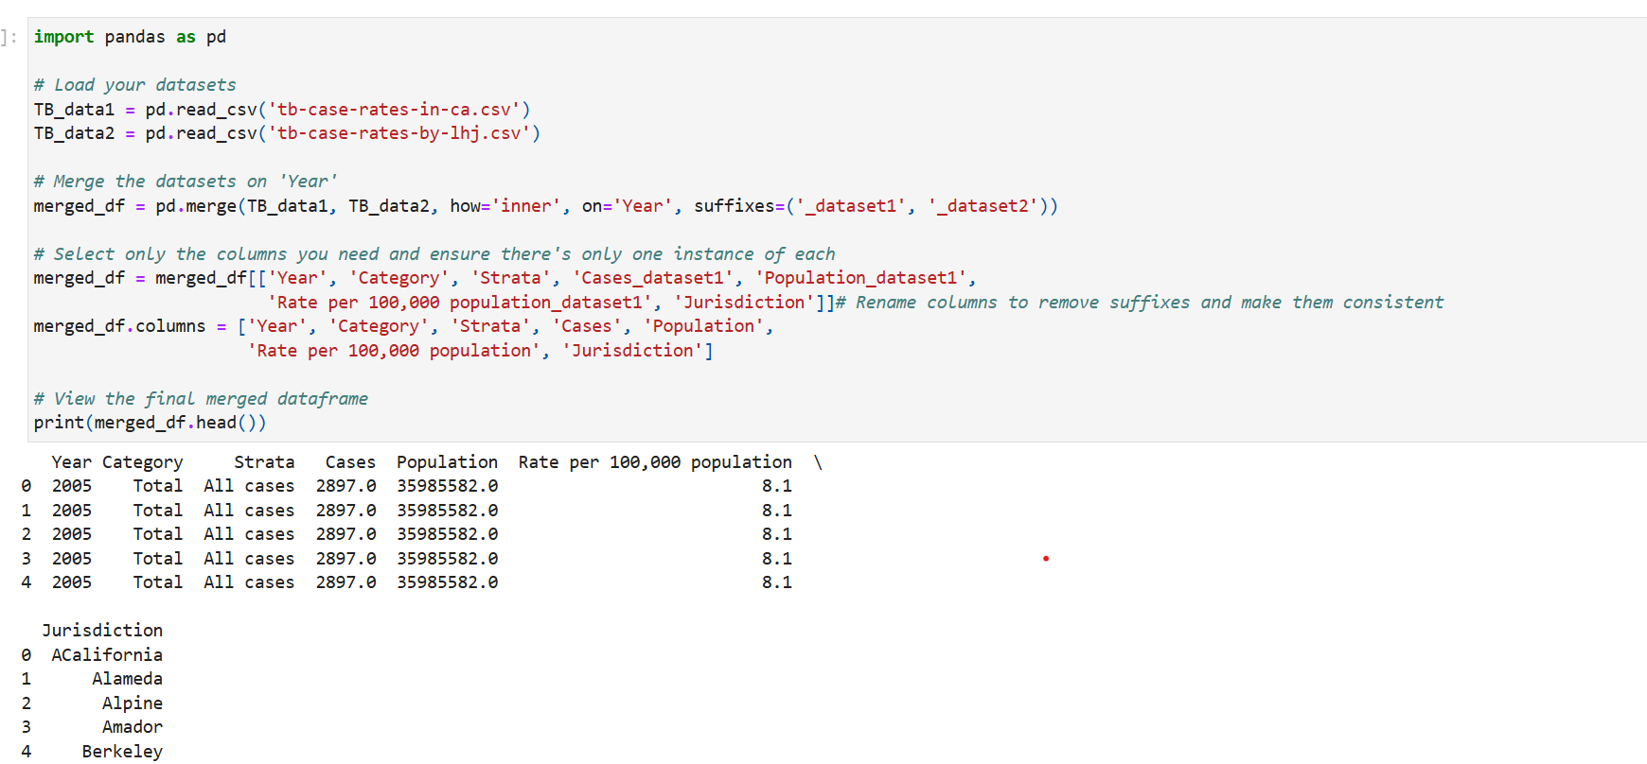
KERNEL METHOD:

Slide 24
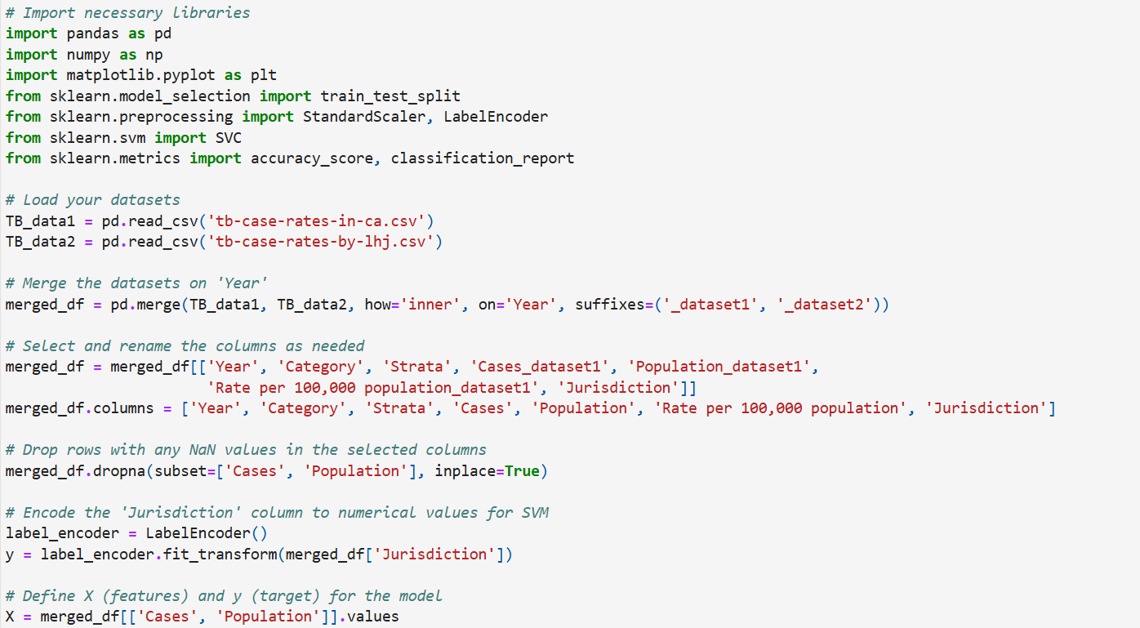

Slide 25
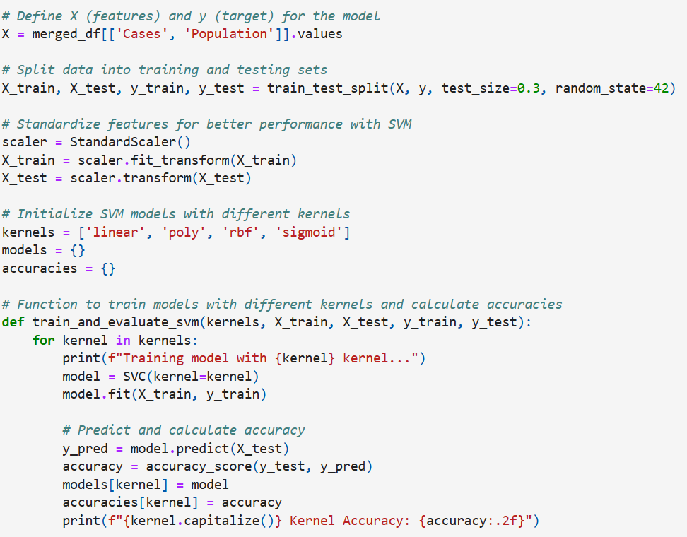
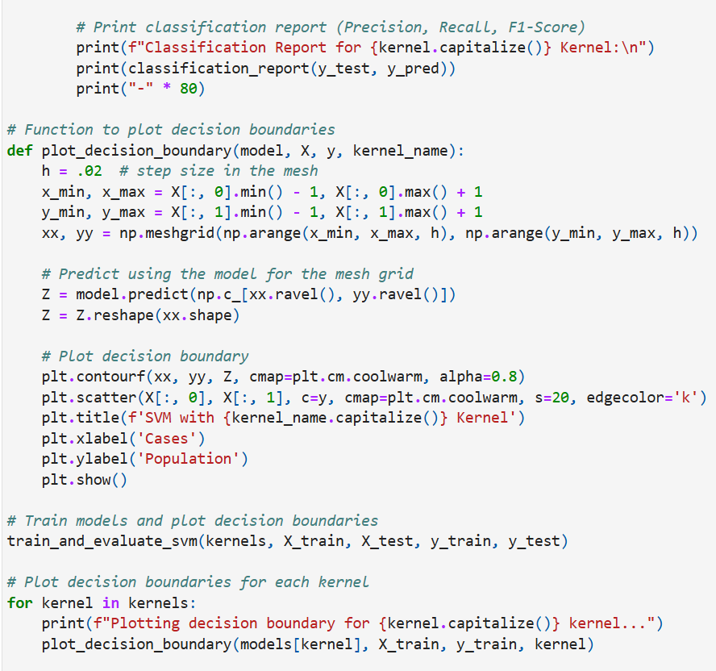

Slide 26
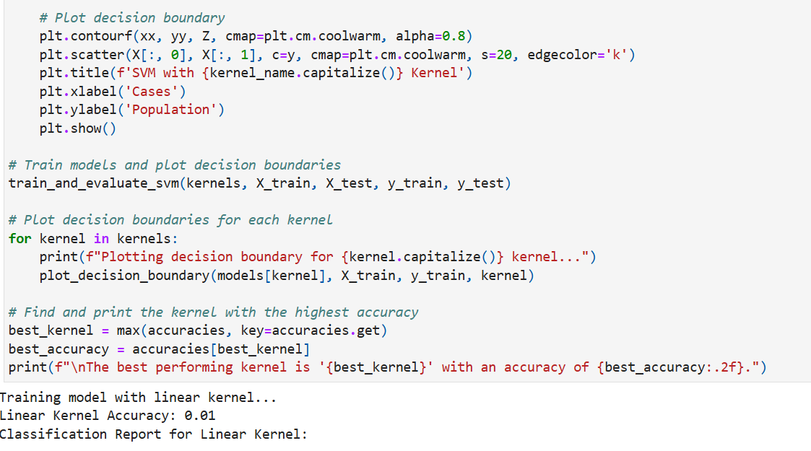

Slide 27
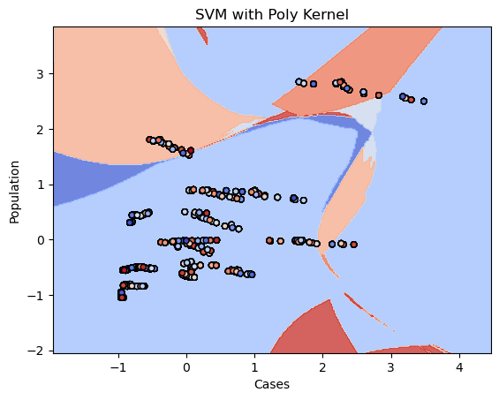
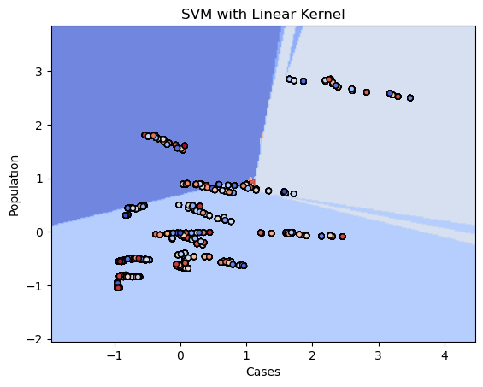

Slide 28
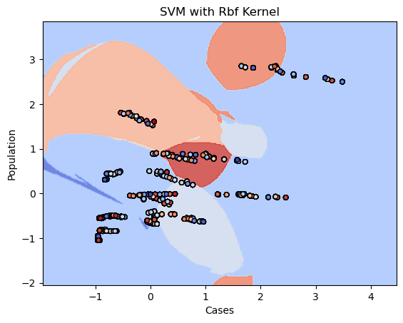
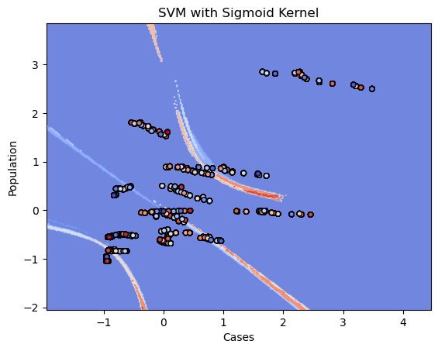

Slide 29
INTERPRETATION:
It describes various SVM models with different kernels—linear, polynomial, RBF, and sigmoid—for classifying tuberculosis cases across jurisdictions using the attributes 'Cases' and 'Population'. To determine which kernel best matches the data, each model's accuracy, precision, recall, and F1-scores are evaluated. Decision boundaries are depicted for each kernel, demonstrating how each technique distinguishes between classes. The linear kernel works best when the data is linearly separable, whereas the RBF kernel is better at dealing with complex, non-linear relationships. Polynomial and sigmoid kernels can also capture non-linear boundaries, although they are more prone to overfitting and produce unpredictable results depending on the data.

Slide 30
Finally, the kernel with the highest accuracy is chosen as the top performance, implying that it generates the most appropriate decision boundary for classifying jurisdictions based on TB case rate and population. This best-performing model is anticipated to be the most reliable for creating jurisdiction-based classifications based on the available attributes. The SVM model with the highest accuracy is the 'sigmoid' kernel, which achieved an accuracy of 0.02

Slide 31
WHICH MODEL HAS MORE ACCUARCY?
The linear kernel model has a low accuracy of 1%, implying that other kernels (such as 'poly', 'rbf', or'sigmoid') may perform required to improve accuracy. similarly, or somewhat better. To find the best-performing kernel, run the entire code and assess each kernel's correctness. If the other kernels produce similarly low results, it is possible that the SVM model's efficiency is restricted by the dataset's properties, and experimenting with different models or further feature engineering may be required to improve accuracy.

Slide 32
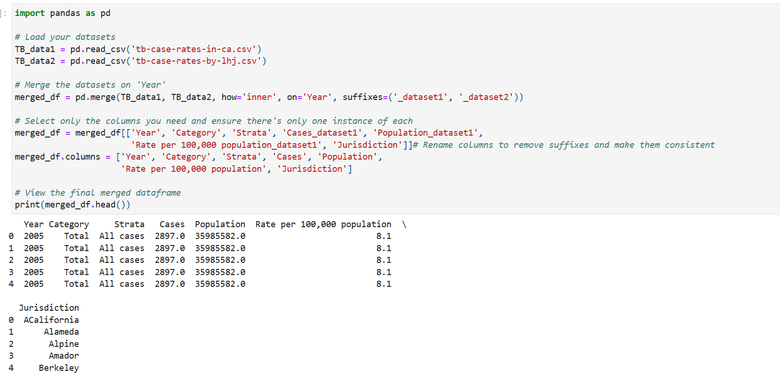
RANDOM FOREST:

Slide 33
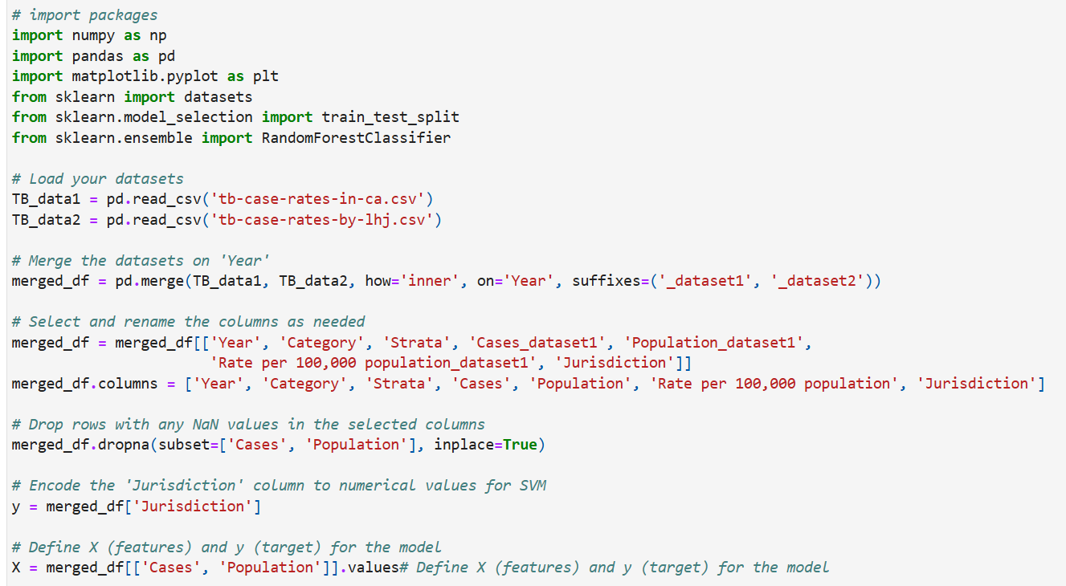
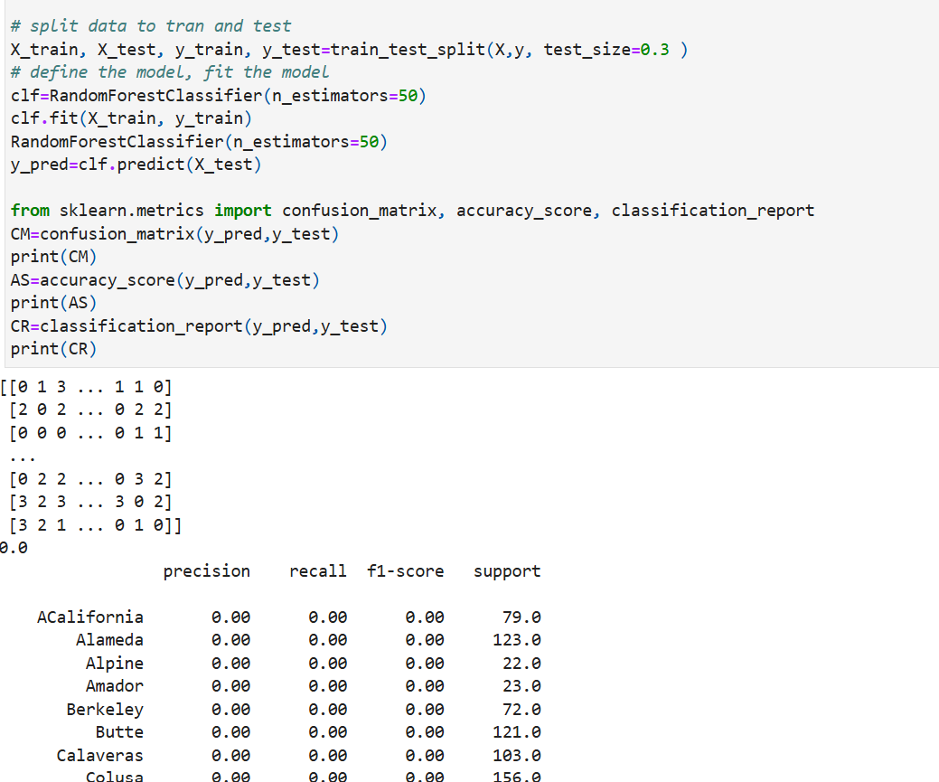

Slide 34
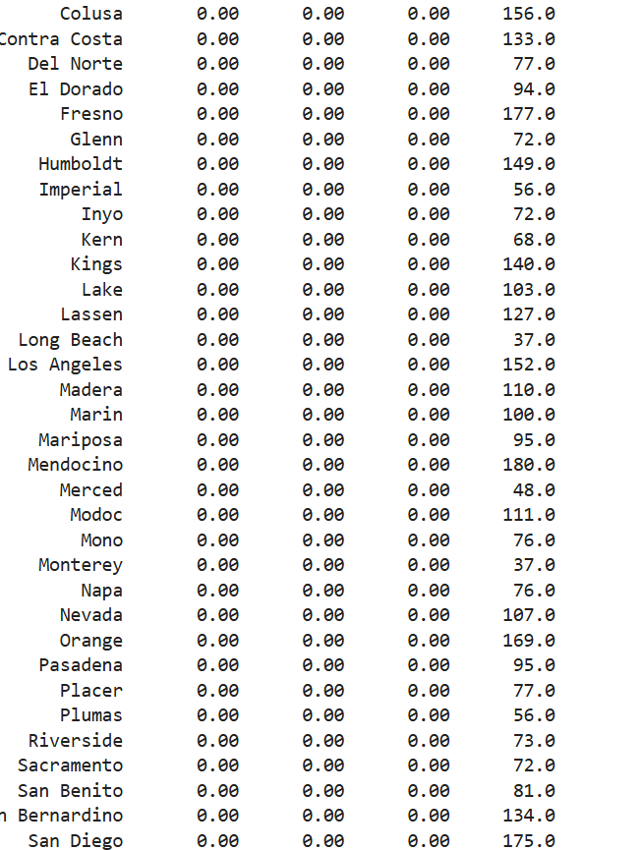
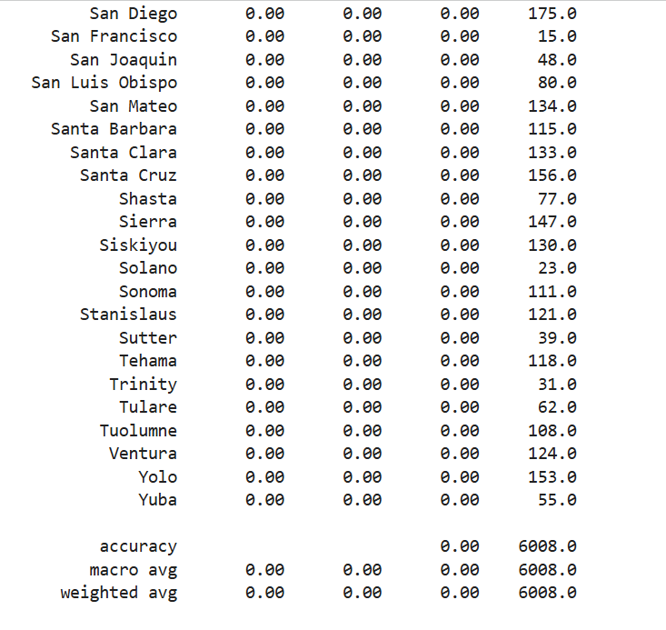

Slide 35
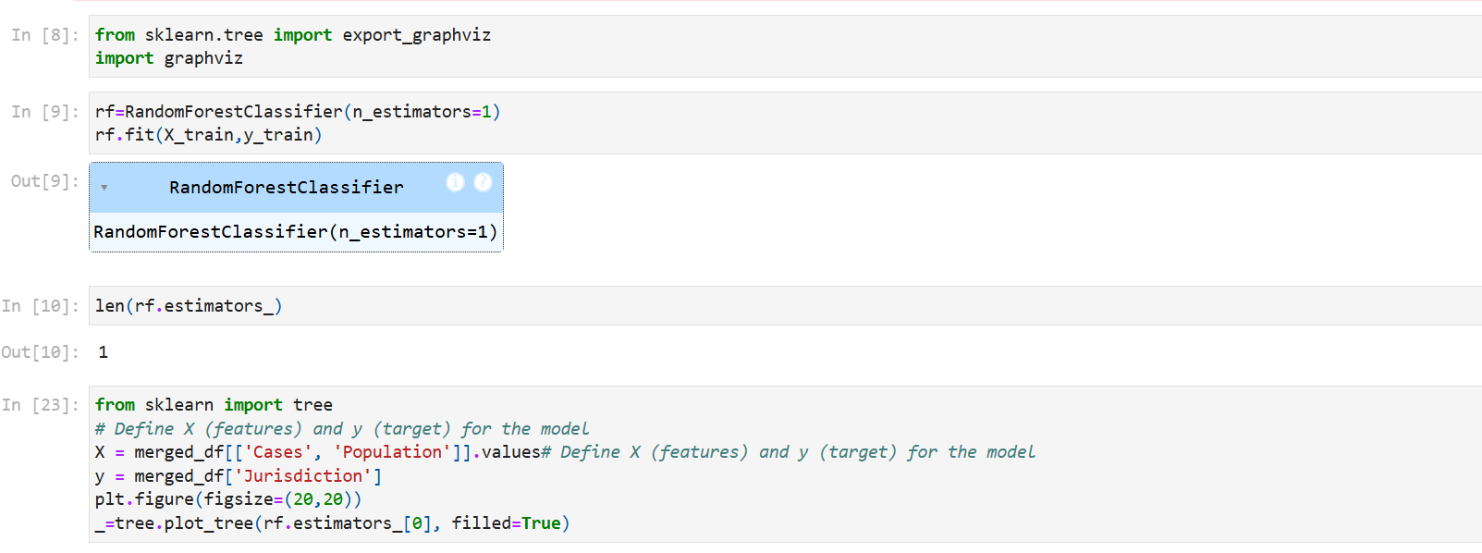

Slide 36
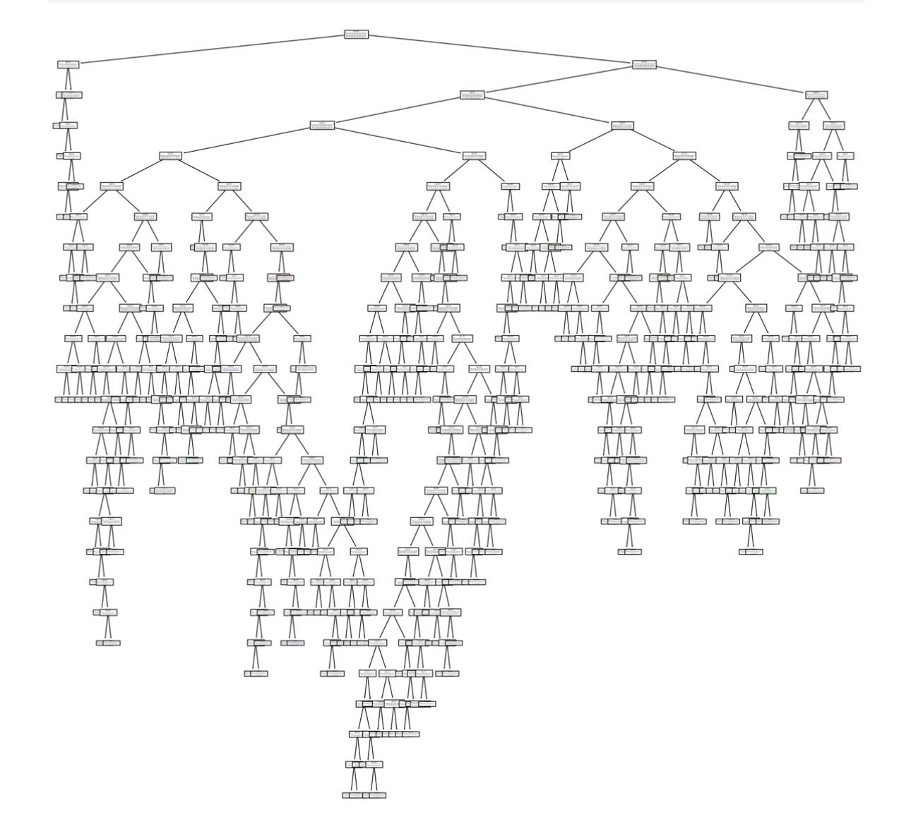

Slide 37
INTERPRETATION:
The presented data shows a trend in tuberculosis case rates in California between 2005 and 2009 suggesting worsening of the situation. The way these years it is possible to notice that overall TB cases number seems to be slightly decreased: from 2897 cases in 2005 to 2466 cases in 2009 year, that is an evidence of TB control efforts strengthening. Additionally, even in comparing to the year 2005, the rate per 100000 population is also decreasing from 8.1 in 2005 to 6.7 in 2009 meaning, though the absolute number of cases is decreasing, the population continues to have a relatively high risk of exposure to TB as a public health threat.
The data also reveals striking differences with reference to the TB incidence per jurisdiction where some jurisdictions reported higher rates compared to other; a situation that may be due to differences in access to health services, socio-economic status and public health measures implemented. These findings highlight the need to pursue selective public health interventions directed at TB affected subgroups as well as jurisdictions that present higher risk for diseases occurrence.

Slide 38
CONCLUSION:
This study on tuberculosis (TB) trends in California employed various predictive models to analyze the dataset, offering valuable insights. Linear Regression revealed no significant correlation between population size and TB cases, suggesting other factors drive TB dynamics. The KNN model outperformed Naïve Bayes with 36% accuracy compared to 33%, benefiting from its ability to capture local patterns. Among SVM models, the sigmoid kernel achieved the highest accuracy at 2%, underscoring the dataset’s complexity and the need for better feature engineering. Random Forest analysis highlighted a decline in TB rates from 2005 to 2009 but also revealed jurisdictional disparities requiring targeted interventions. While KNN was the most effective, the study emphasizes the need for improved preprocessing and exploration of advanced models to enhance predictive accuracy, combining machine learning with domain knowledge to inform strategies for more effective TB control and resource allocation.

Slide 39
CONTRIBUTION OF GROUP MEMBERS:
Gnana Lakshmi Prasanna Nadella – Interpretation ,Visualizations part
Siva Saathwika Vamkeepuram –Interpretation , linear regression models
Revathi Surisetty-Collection of dataset, making visualizations,
Ravali Vuyyala – Linear Regression models, Making PPT slides.

Slide 40
REFERENCES:
Barberis, I., Bragazzi, N., Galluzzo, L., & Martini, M. (2017, March 1). The history of tuberculosis: from the first historical records to the isolation of Koch’s bacillus. https://pmc.ncbi.nlm.nih.gov/articles/PMC5432783/
Department of Public Health. (n.d.). Tuberculosis in California: 2023 Snapshot. https://www.cdph.ca.gov/Programs/CID/DCDC/Pages/TB-in-California-2023-Snapshot.aspx#:~:text=In%202023%2C%202%2C113%20new%20TB,5.4%20cases%20per%20100%2C000%20persons.
Migliori, G., & Huggett, J. (2009, August 31). Tuberculosis: A Comprehensive Clinical reference. European Respiratory Journal. https://publications.ersnet.org/content/erj/34/3/785
Tobin, E. H., & Tristram, D. (2024, August 11). Tuberculosis. StatPearls - NCBI Bookshelf. https://www.ncbi.nlm.nih.gov/books/NBK441916/
World Health Organization: WHO & World Health Organization: WHO. (2024, October 29). Tuberculosis. https://www.who.int/news-room/fact-sheets/detail/tuberculosis#:~:text=Tuberculosis%20(TB)%20is%20an%20infectious,can%20be%20fatal%20without%20treatment.

Slide 41


